Slide 1
What’s Working Today and What’s Coming Tomorrow
New Results from the Lab and the Latest Demographics in Planned Giving
Professor Russell James III, J.D., Ph.D., CFP®
Texas Tech University

Slide 2
New Research Questions
How should you describe these in a way that people are most interested in learning more?
CGAs
General planned giving information
Bequest gifts
General estate planning
Tax benefits
How should you describe them in a way that more people actually understand what you mean?

Slide 3
New Research Questions
What elements of a CGA advertisement make the most people want to get one?
Describing them as what “you” would do or what another donor has done?
Using text alone or text with pictures?
Using pictures of donors or other pictures?
What age should your pictured donor be?

Slide 4
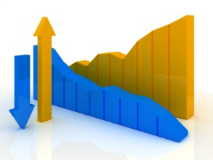
New Research Questions
What does the latest data say about trends in charitable estate planning?

Slide 5
How do you say “CGA” so that people will want to know more?

Slide 6
Suppose you are viewing the website of a charity representing a cause that is important in your life. In addition to a “Donate Now” button, the following buttons appear on the website. Please rate your level of interest in clicking on the button to read the corresponding information.
I am definitely NOT interested
I don’t think I would be interested
I don’t know if I would be interested
I might be interested
I am definitely interested

Slide 7
Survey #1: 2,550 respondents assigned to 5 different surveys
I am definitely interested
__%
__%
__%
__%
__%
Charitable gift annuities
Life income gifts
Get a tax deduction and make a gift that pays you income for life
Gifts that pay you income for life
Gifts that pay you income

Slide 8
Survey #1: 2,550 respondents assigned to 5 different surveys
I am definitely interested
5%
9%
26%
28%
29%
Charitable gift annuities
Life income gifts
Get a tax deduction and make a gift that pays you income for life
Gifts that pay you income for life
Gifts that pay you income

Slide 9
Does this differ for people of different ages, or for people who make substantial donations to charity?

Slide 10
Group Differences
Donor
All
5%
9%
26%
28%
29%
55+
4%
11%
22%
25%
23%
$1k+
5%
10%
26%
27%
26%
I am definitely interested
Charitable gift annuities
Life income gifts
Get a tax deduction and make a gift that pays you income for life
Gifts that pay you income for life
Gifts that pay you income

Slide 11
Is there a better variation of “Gifts that pay you income”?
Survey #2
(2,750 respondents)

Slide 12
Survey #1: 2,750 respondents assigned to 5 different surveys
I am definitely interested
__%
__%
__%
__%
__%
Gifts that pay you income
Gifts that pay you guaranteed income
Gifts that pay you
Gifts that pay you income and avoid taxes
Gifts that pay

Slide 13
Survey #1: 2,750 respondents assigned to 5 different surveys
I am definitely interested
30%
30%
29%
26%
24%
Gifts that pay you income
Gifts that pay you guaranteed income
Gifts that pay you
Gifts that pay you income and avoid taxes
Gifts that pay

Slide 14
What does it mean?
When you click on the phrase, what do you think you are going to see?

Slide 15
Which of the following types of information would you expect when clicking on the button labeled "__[CGA Term]__"
“How to make a gift and, in return, receive lifetime income from the charity”
I definitely did NOT expect this
I didn't really expect this
I don't know if I expected this or not
I guess I expected this
I definitely expected this

Slide 16
“How to make a gift and, in return, receive lifetime income from the charity”
I definitely expected this
Which of the following types of information would you expect when clicking on the button labeled "_______"
__%
__%
__%
__%
__%
Charitable gift annuities
Life income gifts
Gifts that pay you income
Get a tax deduction and make a gift that pays you income for life
Gifts that pay you income for life

Slide 17
“How to make a gift and, in return, receive lifetime income from the charity”
I definitely expected this
Which of the following types of information would you expect when clicking on the button labeled "_______"
15%
24%
30%
31%
34%
Charitable gift annuities
Life income gifts
Gifts that pay you income
Get a tax deduction and make a gift that pays you income for life
Gifts that pay you income for life

Slide 18
Combined Results
“How to make a gift and, in return, receive lifetime income from the charity”
I am definitely interested
I definitely expected this
__%
__%
__%
__%
__%
__%
__%
__%
__%
__%
Charitable gift annuities
Life income gifts
Get a tax deduction and make a gift that pays you income for life
Gifts that pay you income for life
Gifts that pay you income

Slide 19
Combined Results
“How to make a gift and, in return, receive lifetime income from the charity”
I am definitely interested
I definitely expected this
5%
9%
26%
28%
30%
15%
24%
31%
34%
30%
Charitable gift annuities
Life income gifts
Get a tax deduction and make a gift that pays you income for life
Gifts that pay you income for life
Gifts that pay you income

Slide 20
Previous finding (2014 survey)
2014 Survey, 1,418 Respondents, Group F/G
Will Never Be Interested
8%
19%
Interested Now
50%
23%
Receive a tax deduction and make a gift that pays you income for life
Receive a tax deduction and make a gift that pays you income for life
called a “Charitable Gift Annuity”

Slide 21
What is the best “front door” phrase to make people want to read more PG info?

Slide 22
What is the best “front door” phrase to get people to read about planned giving information?
They have to be interested in finding out more
They have to expect to see planned giving information (i.e., not “bait and switch”)

Slide 23
What is the best “front door” phrase to get people to read about planned giving information?
They have to be interested in finding out more
Suppose you are viewing the website of a charity representing a cause that is important in your life. In addition to a “Donate Now” button, the following buttons appear on the website. Please rate your level of interest in clicking on the button to read the corresponding information.

Slide 24
Survey #1: 2,550 respondents
I am definitely interested
__%
__%
__%
__%
__%
__%
Gift planning
Planned giving
Giving now & later
Other ways to give
Other ways to give smarter
Other ways to give cheaper, easier, and smarter

Slide 25
Survey #1: 2,550 respondents
I am definitely interested
3%
4%
7%
16%
20%
23%
Gift planning
Planned giving
Giving now & later
Other ways to give
Other ways to give smarter
Other ways to give cheaper, easier, and smarter

Slide 26
Is there a better way to phrase,
“Other ways to give cheaper, easier, and smarter”?
Survey #2
(2,750 respondents)

Slide 27
Survey #2: 2,750 respondents
I am definitely interested
__%
__%
__%
__%
__%
Other gifts
More ways to give
Give other ways
How to give cheaper, easier, and smarter
Other ways to give cheaper, easier and smarter

Slide 28
Survey #2: 2,750 respondents
I am definitely interested
8%
14%
15%
21%
22%
Other gifts
More ways to give
Give other ways
How to give cheaper, easier, and smarter
Other ways to give cheaper, easier and smarter

Slide 29
What is the best “front door” phrase to get people to read about planned giving information?
They have to expect to see planned giving information (i.e., not “bait and switch”)
Which of the following types of information would you expect when clicking on the button labeled "_______"

Slide 30
Which of the following types of information would you expect when clicking on the button labeled "_______“? How to…
12 types of planned giving information
make a gift of stocks
make a gift of bonds
make a gift of real estate
make a gift in your will
make a gift in your living trust
make a gift by naming a charity as death beneficiary of your life insurance policy
make a gift by naming a charity as death beneficiary of your IRA or retirement account
make a gift by naming a charity as death beneficiary of your bank account
make a gift and, in return, receive lifetime income from the charity
avoid capital gains taxes by making charitable gifts
avoid estate taxes by making charitable gifts
avoid income taxes by making charitable gifts

Slide 31
Overall average for all 12 types of planned giving information
I definitely expected this
__%
__%
__%
__%
__%
__%
Gift planning
Planned giving
Giving now & later
Other ways to give
Other ways to give smarter
Other ways to give cheaper, easier, and smarter

Slide 32
Overall average for all 12 types of planned giving information
I definitely expected this
20%
12%
7%
15%
19%
12%
Gift planning
Planned giving
Giving now & later
Other ways to give
Other ways to give smarter
Other ways to give cheaper, easier, and smarter

Slide 33
Combined Results
12 types of PG info average
I am definitely interested
I definitely expected this
3%
4%
7%
16%
20%
23%
20%
12%
7%
15%
19%
12%
Gift planning
Planned giving
Giving now & later
Other ways to give
Other ways to give smarter
Other ways to give cheaper, easier, and smarter

Slide 34
Should you reference tax benefits?
How should you do so?

Slide 35
Previous finding (2014 survey)
2014 Survey, 1,904 Respondents, Groups D/E/F
Will Never Be Interested
8%
14%
20%
Interested Now
50%
33%
31%
Receive a tax deduction and make a gift that pays you income for life.
Make a gift that pays you income for life and receive a tax deduction.
Make a gift that pays you income for life.

Slide 36
Previous finding (2014 survey)
2014 Nov. Survey, 1,006 Respondents, Groups X/Y
Will Never Be Interested
8%
20%
Interested Now
50%
31%
Avoid capital gains tax by making a gift of stocks or bonds to a charity.
Make a gift of stocks or bonds to charity.

Slide 37
I might be/am definitely interested
Please rate your level of interest in clicking on the button to read the corresponding information.
__%
__%
__%
__%
__%
__%
Avoid taxes by giving stocks
How to avoid taxes by giving stocks
Save taxes by giving stocks
Tax tips when giving stocks
Avoiding capital gains taxes by giving stocks
Giving stocks

Slide 38
I might be/am definitely interested
Please rate your level of interest in clicking on the button to read the corresponding information.
28%
27%
25%
24%
24%
16%
Avoid taxes by giving stocks
How to avoid taxes by giving stocks
Save taxes by giving stocks
Tax tips when giving stocks
Avoiding capital gains taxes by giving stocks
Giving stocks

Slide 39
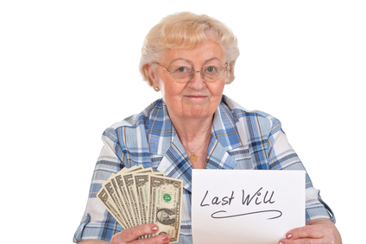
How should you say that you want to share information about making a gift in a will?

Slide 40
I might be/
am definitely interested
__%
__%
__%
__%
__%
__%
__%
Gifts in wills
Gifts in a will
Tax tips for gifts in a will
How to make gifts in a will
Gifts in your will
Will planning
Bequest gifts

Slide 41
I might be/
am definitely interested
26%
26%
27%
27%
28%
28%
18%
Gifts in wills
Gifts in a will
Tax tips for gifts in a will
How to make gifts in a will
Gifts in your will
Will planning
Bequest gifts

Slide 42
Previous finding (2014 survey)
2014 Survey, 1,246 Respondents, Groups D/E
Will Never Be Interested
12%
14%
Interested Now
23%
12%
Make a gift to charity in my will
Make a bequest gift to charity

Slide 43
Don’t use “Bequest”
2014 Survey, 1,203 Respondents, Groups D/C
Will Never Be Interested
26%
31%
Interested Now
12%
9%
Make a gift by naming a charity as a transfer-on-death beneficiary on a bank account or retirement account.
Make a bequest gift by naming a charity as a beneficiary on a bank account or retirement account.

Slide 44
What about broader estate planning terms?

Slide 45
I might be/
am definitely interested
__%
__%
__%
__%
__%
__%
Will planning
Legacy planning
Legacy giving
Planning with trusts & estates
Estate planning
Estate giving

Slide 46
I might be/
am definitely interested
28%
18%
18%
17%
16%
14%
Will planning
Legacy planning
Legacy giving
Planning with trusts & estates
Estate planning
Estate giving

Slide 47
Instead of a broad estate planning term, what about a long list of several terms?

Slide 48
I might be/
am definitely interested
__%
__%
__%
__%
Gifts in wills
Gifts in wills, trusts, or retirement accounts
Gifts in wills, trusts, retirement accounts, or life insurance
Gifts in wills & trusts

Slide 49
I might be/
am definitely interested
26%
25%
24%
23%
Gifts in wills
Gifts in wills, trusts, or retirement accounts
Gifts in wills, trusts, retirement accounts, or life insurance
Gifts in wills & trusts

Slide 50
Do people expect to see a broad range of estate planning information?
How to make a gift in your will
How to make a gift in your living trust
How to make a gift by naming a charity as death beneficiary of your life insurance policy
How to make a gift by naming a charity as death beneficiary of your IRA or retirement account
How to make a gift by naming a charity as death beneficiary of your bank account

Slide 51
Gifts
in wills
82%
49%
51%
48%
52%
Gifts in wills, trusts, retirement accounts or life insurance
80%
76%
63%
59%
50%
I definitely/ guess I expected this
Estate Planning
64%
53%
48%
46%
46%
Make a gift in your will
Make a gift in your living trust
Make a gift by naming a charity as death beneficiary of your life insurance policy
Make a gift by naming a charity as death beneficiary of your IRA or retirement account
Make a gift by naming a charity as death beneficiary of your bank account

Slide 52
26%
16%
24%
I might be/am definitely interested
Gifts in wills
82%
49%
51%
48%
52%
Estate Planning
64%
53%
48%
46%
46%
Gifts in wills, trusts, retirement accounts or life insurance
80%
76%
63%
59%
50%
Make a gift in your will
Make a gift in your living trust
Make a gift by naming a charity as death beneficiary of your life insurance policy
Make a gift by naming a charity as death beneficiary of your IRA or retirement account
Make a gift by naming a charity as death beneficiary of your bank account

Slide 53
Testing Charitable Gift Annuity Ad Messages

Slide 54
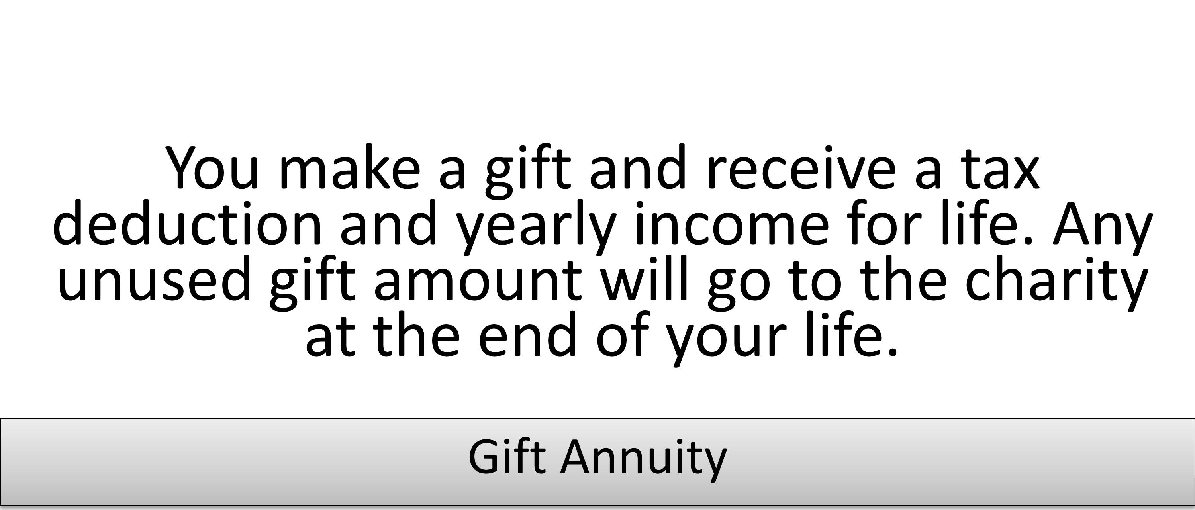
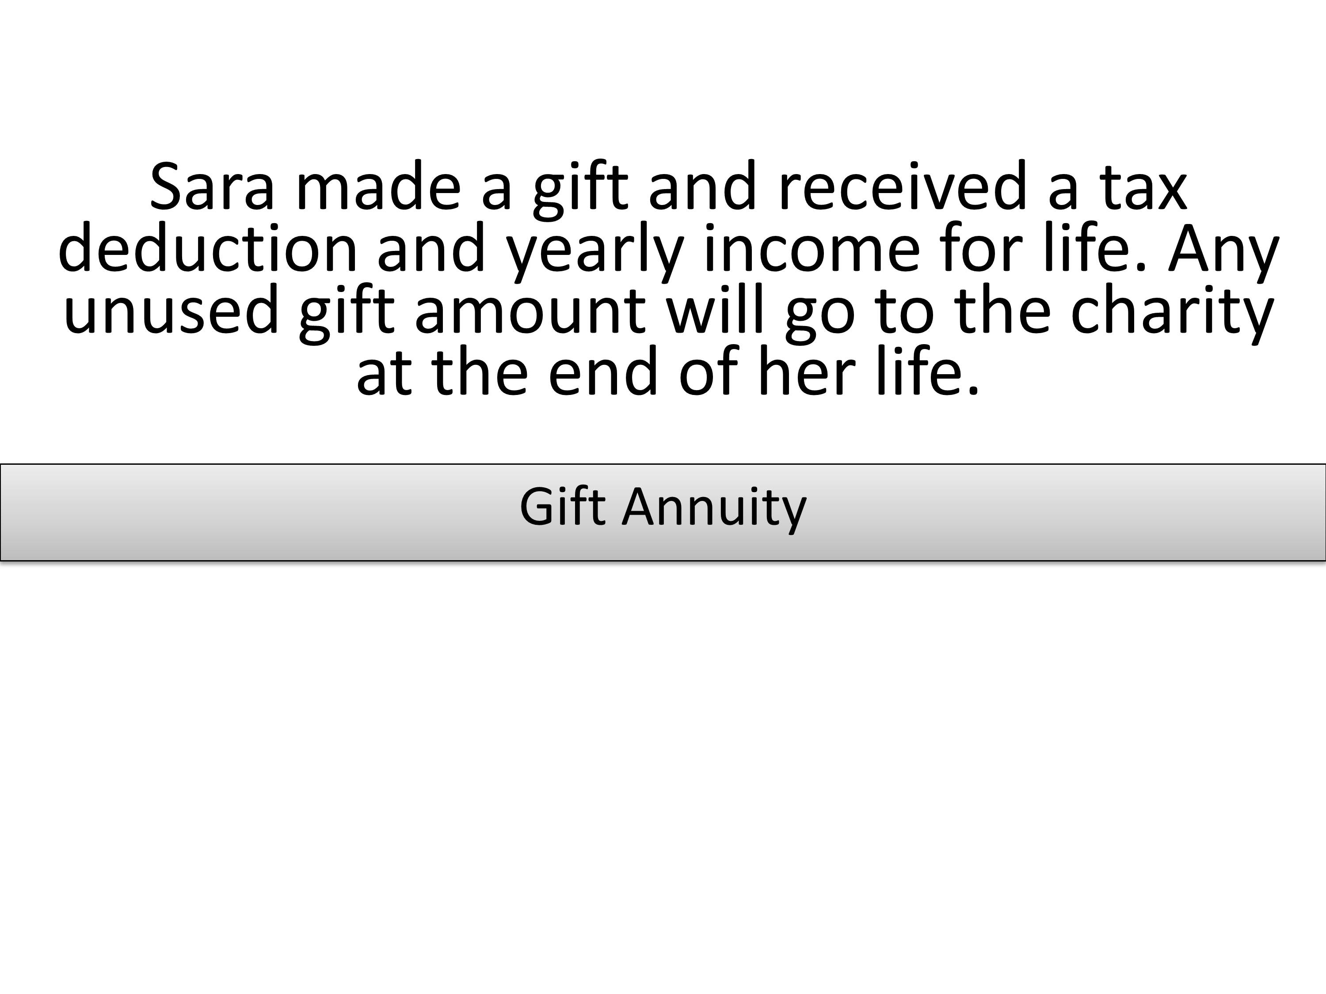
What “you” would do or what another donor has done?
Interested Now
Definitely/somewhat/slightly
All: ____%
55+: ____%
All: ____%
55+: ____%
Please rate your interest in pursuing the above described charitable giving arrangement

Slide 55
What “you” would do or what another donor has done?
Interested Now
Definitely/somewhat/slightly
All: 33.5%
55+: 23.2%
All: 38.6%
55+: 38.6%
Please rate your interest in pursuing the above described charitable giving arrangement

Slide 56
Text only or text and donor picture?
Please rate your interest in pursuing the above described charitable giving arrangement: % Interested now (definitely/somewhat /slightly)
All: ___%
55+: ___%
All: ___%
55+: ___%

Slide 57
Text only or text and donor picture?
Please rate your interest in pursuing the above described charitable giving arrangement: % Interested now (definitely/somewhat /slightly)
All: 38.6%
55+: 38.6%
All: 31.1%
55+: 29.8%

Slide 58
What’s the problem with the donor picture? Is it just this photo? This donor age? Is it photos in general or what?

Slide 59
Interested now (definitely/somewhat /slightly)
55+
___%
___%
___%
35-54
___%
___%
___%
U-35
___%
___%
___%

Slide 60
Interested now (definitely/somewhat /slightly)
55+
24.4%
22.0%
41.1%
35-54
38.4%
47.4%
30.6%
U-35
44.5%
32.6%
30.2%

Slide 61
How do these compare with text only or a non-donor photo?
Text only

Slide 62
Interested now (definitely/somewhat /slightly)
55+
1st 44.4%
3rd 28.3%
24.4%
22.0%
41.1%
35-54
3rd
40.1%
2nd 44.6%
38.4%
47.4%
30.6%
U-35
3rd 34.7%
2nd 36.4%
44.5%
32.6%
30.2%
All
1st 40.1%
2nd 36.5%
35.8%
34.0%
34.0%
Young
Middle Older

Slide 63
Age matched donor pictures are OK
Otherwise, use text only or a different picture

Slide 64
Avoid death reminders
Previous findings
People are less interested in “make a gift to charity in my last will & testament that
will take effect at my death” than when the final phrase is removed.
Stories of living bequest donors are more influential than otherwise identical stories of deceased bequest donors
New finding
Replacing “if the annuity holder lives
up to different ages” with
“depending on the age when the
annuity holder dies” and “each year you live” with “until you die” reduces those interested in purchasing an annuity from 36% to 26%.
Solving the annuity puzzle: The role of mortality salience in retirement savings decumulation decisions, Journal of Consumer Psychology, 2016 (forthcoming), L. C. Salisbury & G. Y. Nenkov

Slide 65
What does the latest data say about trends in charitable estate planning?

Slide 80
What’s Working Today and What’s Coming Tomorrow
New Results from the Lab and the Latest Demographics in Planned Giving
Professor Russell James III, J.D., Ph.D., CFP®
Texas Tech University

